Slide 1



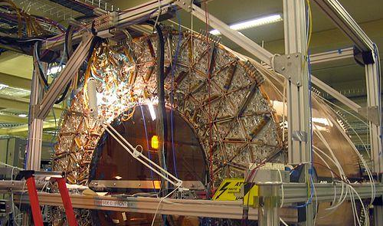
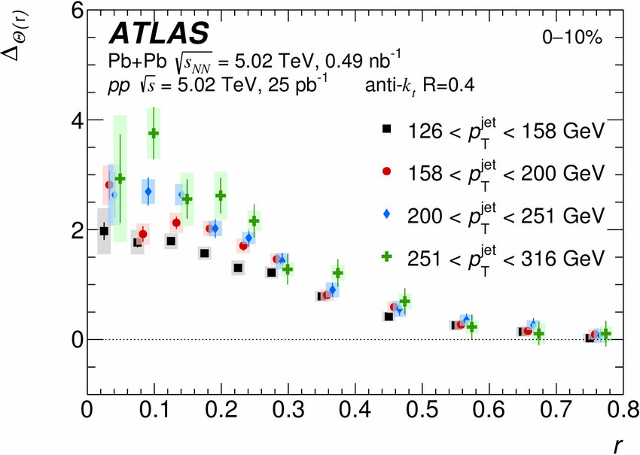
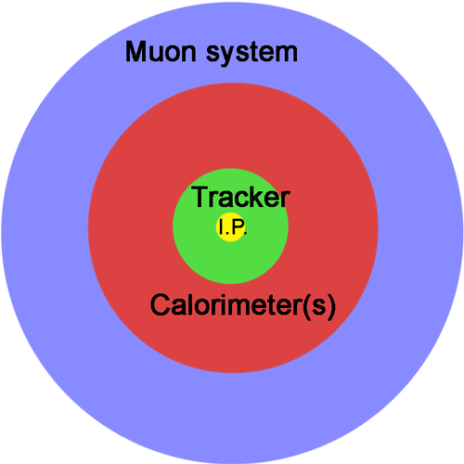
High-Energy Physics:
Detectors
Belanovich V.
Pankov D.
Namdag
Authors:
Affiliation:
Laboratory of Data Analysis for High Energy Physics, Tomsk State University
Group 2
INTRODUCTION
RESULTS
High-energy physics investigates particle collisions at extreme energies. This allows us to reproduce conditions similar to those just after the Big Bang, enabling us to study particles such as quarks and leptons, which cannot be directly observed in nature.
HEP speaks the language of elementary particles
Particle detectors measure fundamental properties through precise interactions. The magnetic field bends charged particle tracks, where a tightly curved track indicates low momentum according to the formula p = 0.3·B·r (p in GeV/c, B in Tesla, r in meters). Particles deposit energy in calorimeters - for example, a 10 GeV electron creates a large shower in the EM calorimeter, measured through light yield in crystals or ionization in liquid argon. Charge - track → detector hit - signal processing.
CONCLUSION
During the research, we learned the circuit diagrams of the HEP detectors and understood how they detect particles.
CONTEXT
Detectors, like ATLAS, act as giant "digital cameras" that capture the traces particles leave behind.The experiment is based on the collision of protons and the analysis of the results: Inner tracking detectors→ Energy measurement → Muon identification → Magnetic bending.
METHODS
Modern particle detectors are built like giant onions. Each layer has a specific task:
Tracking detectors: measure the paths of charged particles. They can be silicon pixel and strip.
Calorimeters: stop particles and measure their energy. ECAL and HCAL capture most of the visible energy in a collision.
Muon systems: detect muons, which penetrate the other layers. Use technologies like: Drift tubes and Resistive Plate Chambers
Magnets: bend charged particles, allowing measurement of momentum.
Email: vbelanovich15@gmail.com

